Slide 1
AME20216 - Lab I L4 - Electronics

Slide 2
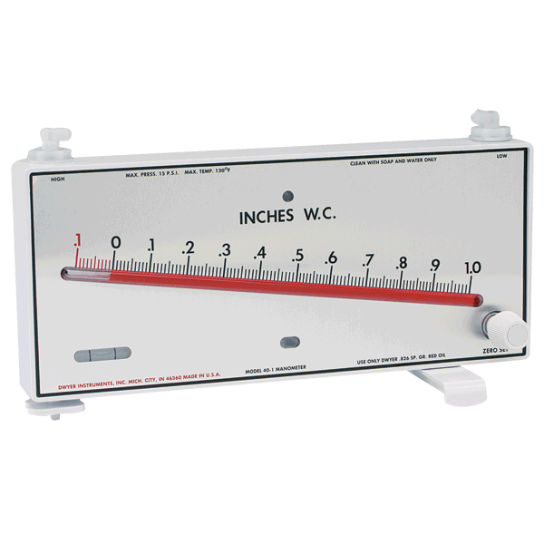
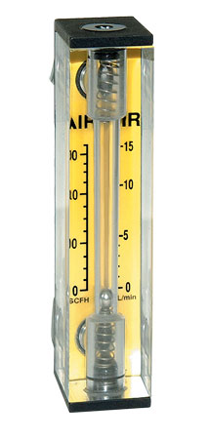
Transducers
Rotameter
Manometer
http://www.dwyer-inst.com
Omega.com

Slide 3
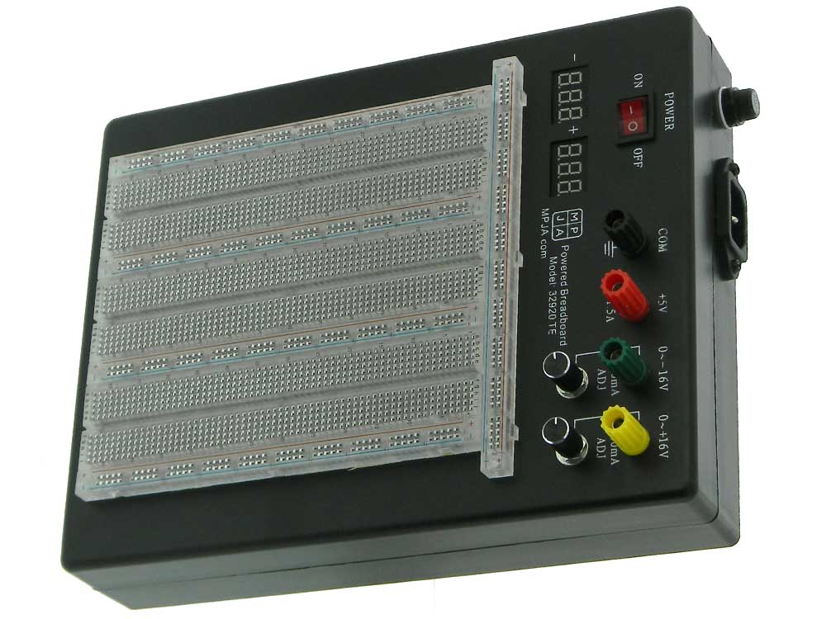
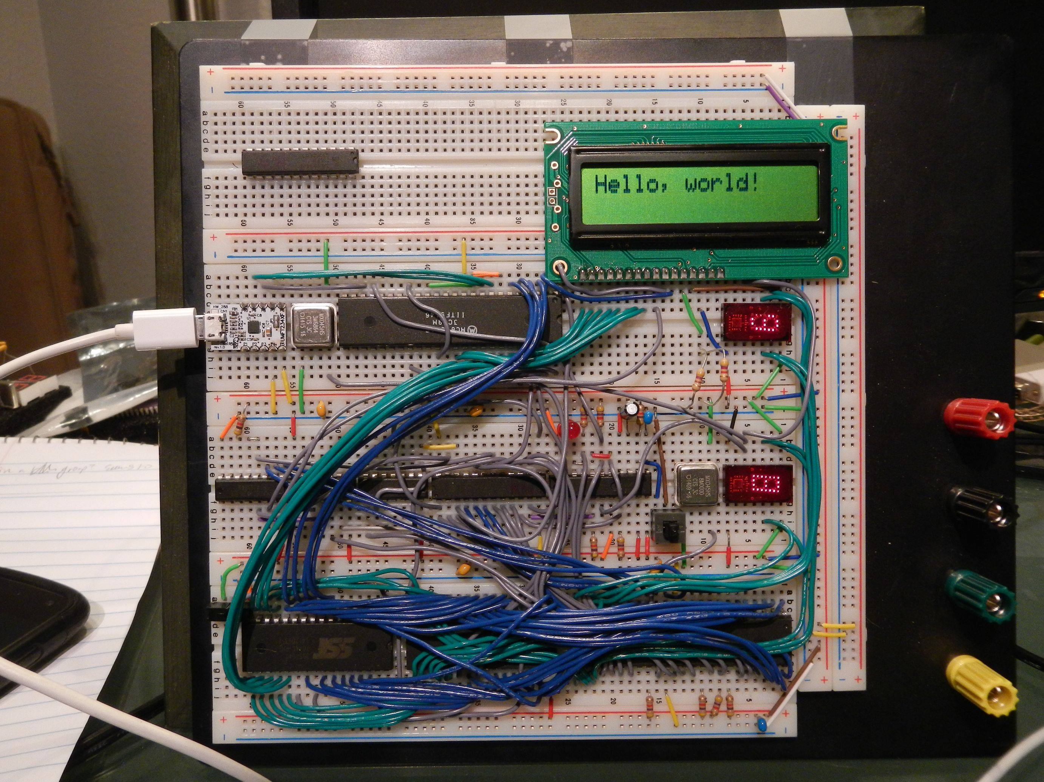
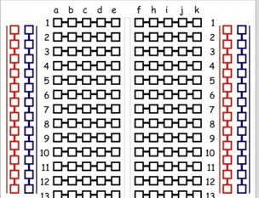
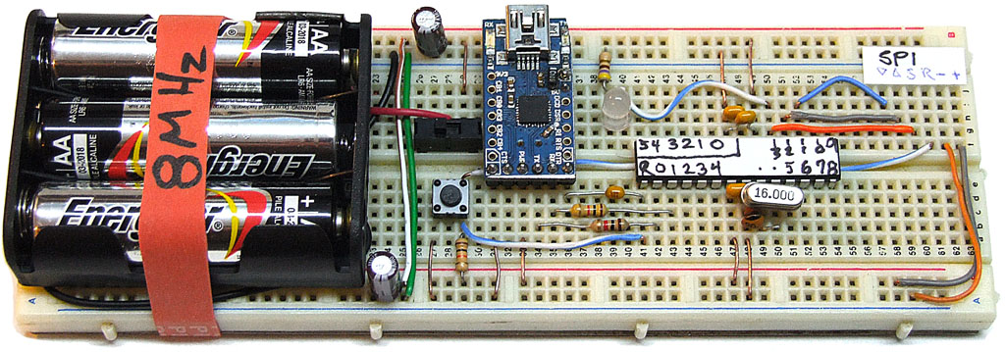
A3 – Electronics I
Solderless breadboard

Slide 4
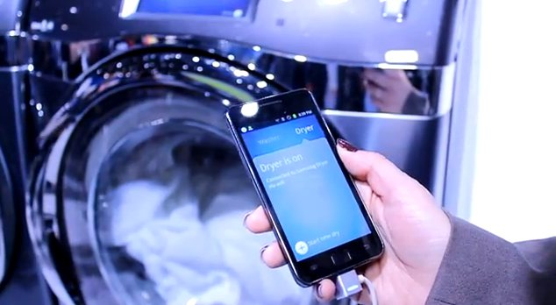
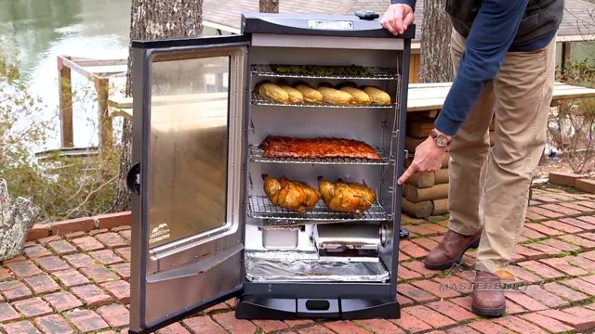
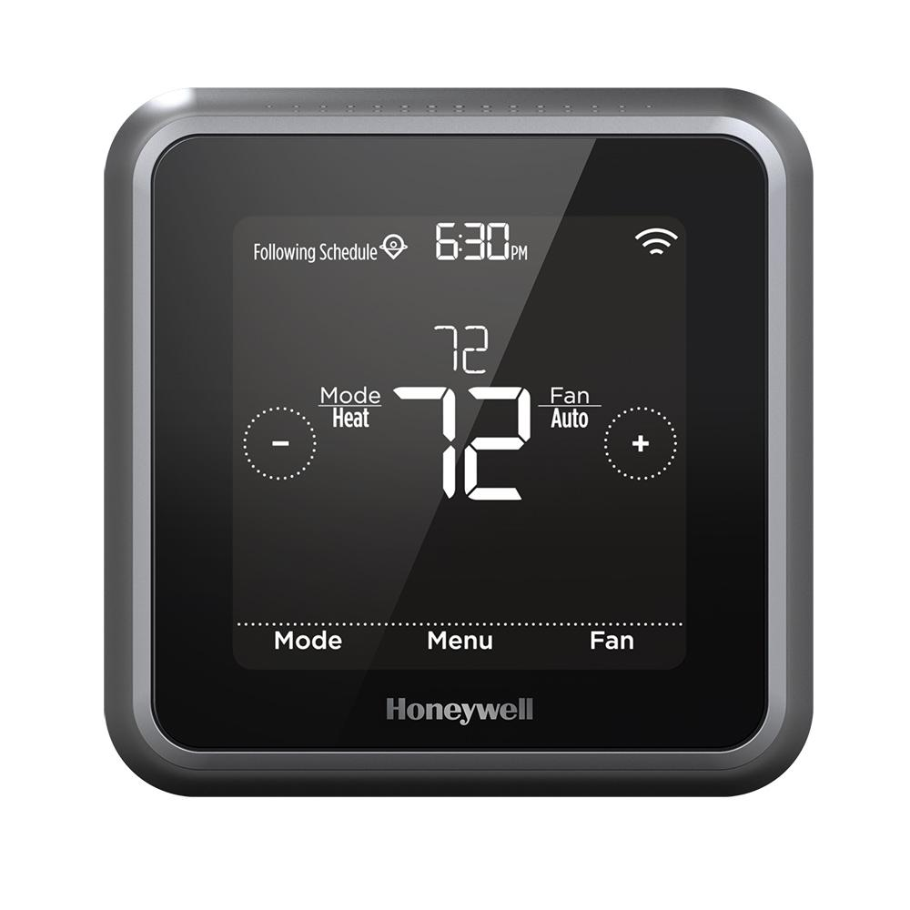
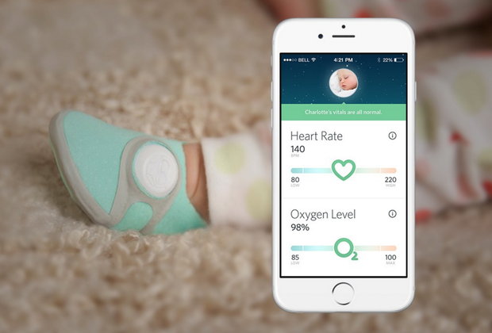
Internet of Things (IoT) – Sensors galore!

Slide 5
Electricity: Review of Physics II
Charge: q [Coulombs]
+
-
Current: [C/s] = [Amperes]
Voltage: V “electrostatic potential energy”
[Joules/Coulomb] = [Volts]

Slide 6
Ohm’s Law
Resistance: R [Ohms] = [Ω]
Resistors in Parallel
Resistors in Series
R₁
R₁
R₂
R₂

Slide 7
Joule Heating
Power Dissipated:
[Joules/second] = [Watts] = [W]
Electrons collide with metal atoms, transfer kinetic energy.
Metal heats up.
Always valid
Only valid for
“Ohmic” devices

Slide 8
Digital Multimeter (DMM)
Can measure current, voltage, and resistance.

Slide 9
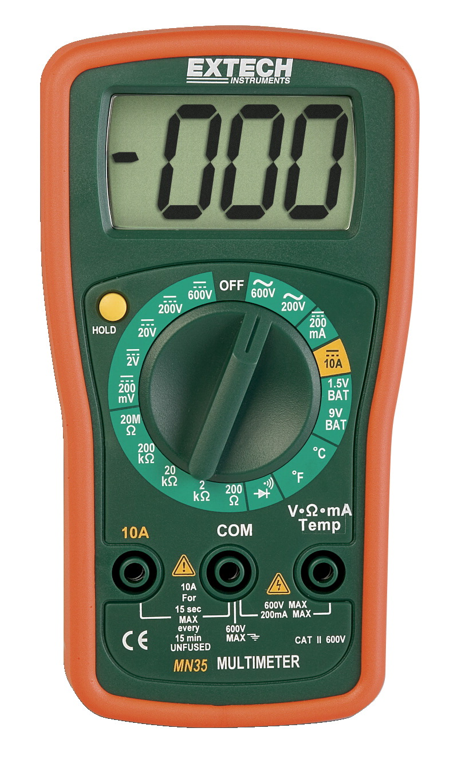
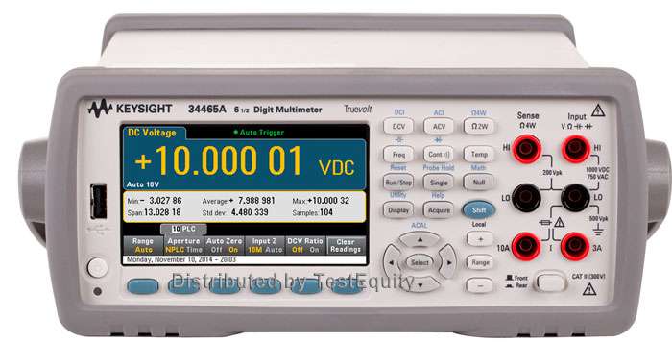
Digital Multimeters
Can measure current, voltage, and resistance.
Extech Handheld DMM
Keysight Precision DMM

Slide 10
Kirchhoff’s Circuit Laws
1. Current Law: Current IN = Current OUT
2. Voltage Law: sum of voltages around a closed loop is Zero

Slide 11
“Floating” voltage divider circuit
“Grounded” voltage divider circuit
Assume the ground is always at zero volts.

Slide 12
Voltage Divider

Slide 13
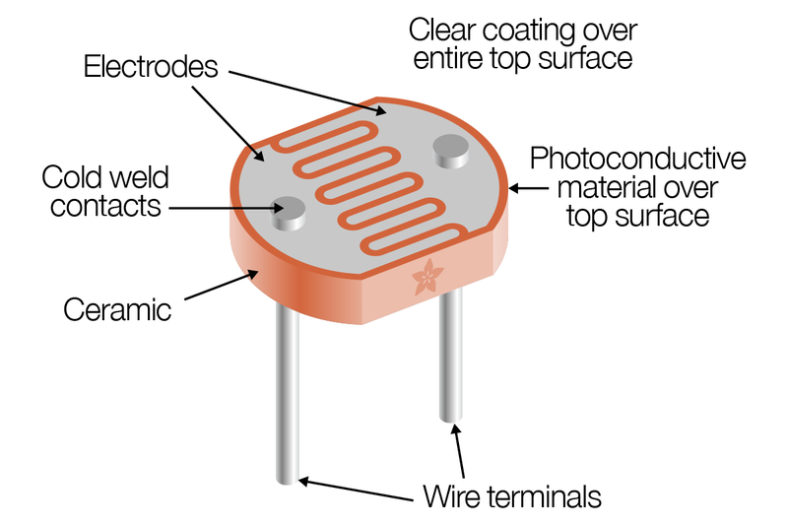
Cadmium Sulfide (CdS) Photocell
Resistance of Photocell changes when illuminated.

